Slide 1
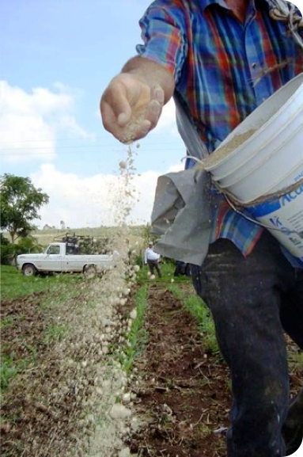
The Potential of Remineralization
Transforming ecological, economic and social challenges on a regional and global scale
Advancing Renewable Energy in Latin America and Integrated Farm Energy Systems, RELACCx, Puerto Rico, November 19, 2014
Notes:
Larger picture of remineralization and our organization
Remineralization addresses local and global challenges – Thesis statement, if you will

Slide 2
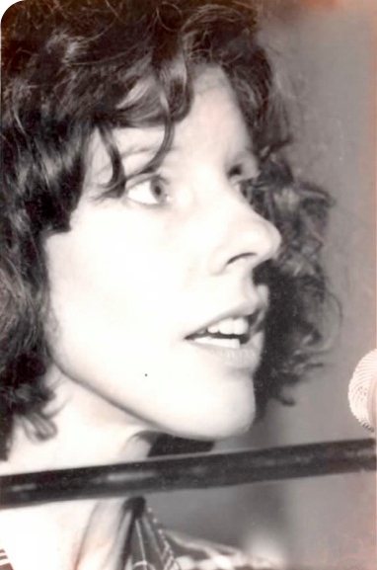
Joanna Campe,
Founder and Executive Director of Remineralize the Earth, advocating remineralization in the 1980s.
http://www.remineralize.org
It is the vast micro-universe of the soil that supports all life and it is mineral rich and healthy soils that are crucial for sequestering carbon and stabilizing our climate.
Notes:
Exposition of the Story
Mentioning Bill and his connection and vice versa
How I started and how & how long I’ve been engaged

Slide 3
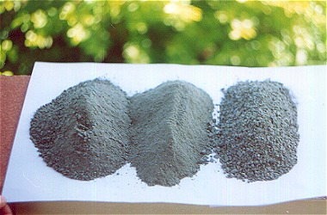
What is remineralization?
The process of recycling the minerals and trace elements of finely ground rock dust and sea minerals back into our soils.
Notes:
What remineralization is….
----- Meeting Notes (11/14/14 17:24) -----
Change definition verb tense

Slide 4
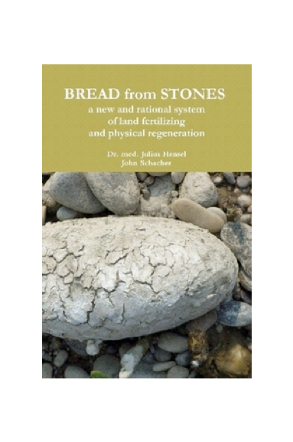
Research in Europe
Our most optimistic expectations are no less than the realization of an old dream:
'What will fertilizing with stone dust accomplish? It will turn stones into bread… make barren regions fruitful and feed the hungry.' Julius Hensel, Bread from Stones (1894)
Taken from Agricultural Alchemy: Stones into Bread
Notes:
What will fertilizing with stone dust accomplish? – What is the science behind remineralization?
Biomimicry
Quaternary Sciences
Survival of Civilization – Man can survive an ice age but civilization cannot
Piggy-backing off quaternary sciences
From micro-universe of the soil to interglacial cycle
Minerals play a key role
It will turn stones into bread… -- How can we turn this into reality?
What processes were out there?
Who are
Make barren regions fruitful and feed the hungry -- Projects from RTE
Cameroon - Future
Costa Rica – 2008

Slide 5
Agrogeologists are the Heroes
Bill Fyfe
Ward Chesworth
Peter van Straaten
Canada
Canada
Canada
Othon Leonardos
Suzi Huff Theodoro
Eder Souza Martins
Brazil
Brazil
Brazil
Jean Pierre Tchouankoue
Cameroon
“Geology in service of agriculture”
Peter van Straaten, Rocks for Crops 2002
Notes:
Byline: “Geology in service of agriculture” – Peter van Straaten, Rocks for Crops 2002

Slide 6
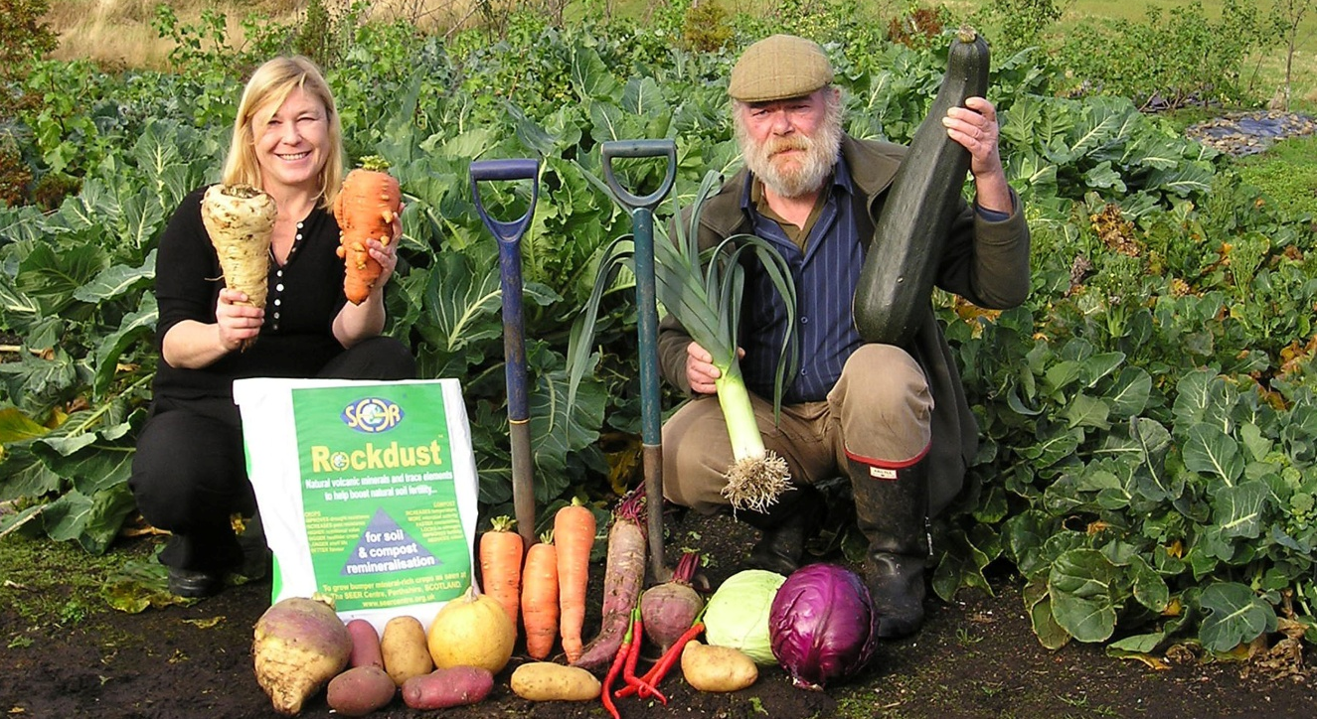
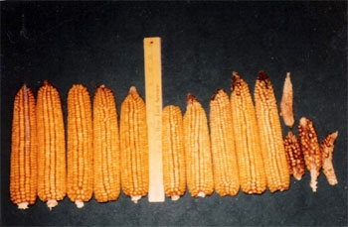
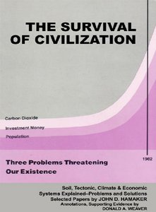
The Grassroots Movement
SEER Centre, Scotland
Year 2
Year 1
No rock dust
Increased:
28% protein
47% calcium
57% phosphorus
60% magnesium
90% potassium
Notes:
In an area of sparse rainfall and dry summers, and with no irrigation, the corn produced 65 bushels per acre, compared to yields of under 25 bushels per acre from other local farms.
Independent analyses revealed the following increases in nutrients, compared with the same type of corn grown with chemical fertilizers nearby:
28% more protein
47% more calcium
57% more phosphorus
60% more magnesium
90% more potassium

Slide 7
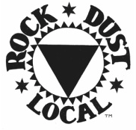
Commercial Involvement
As the grassroots movement increased so too did the demand for remineralization products.
Then
Only a handful of US companies in the 1980s marketing rock dust
Now
US
Europe
South America
Asia: China, Indonesia, Vietnam

Slide 8
A Need for Convergence
Grassroots
Movement
Research
Commercial Activity

Slide 9
Mission
Remineralize the Earth (RTE) promotes the use of natural land and sea based minerals to restore soils and forests, produce more nutritious food, and remove excess CO₂ from the atmosphere.
Notes:
Add light background photo

Slide 10
Vision
Given the immediate and growing threats of climate change, desertification, and increased food insecurity, RTE, through soil remineralization, is helping to create better soils, better food and a better planet.
Through our research, education, advocacy, partnerships, and implementation we are:
Regenerating soils and forests around the world
Increasing the nutritional quality and yield of food production
Stabilizing the climate
Notes:
Add light background photo

Slide 11
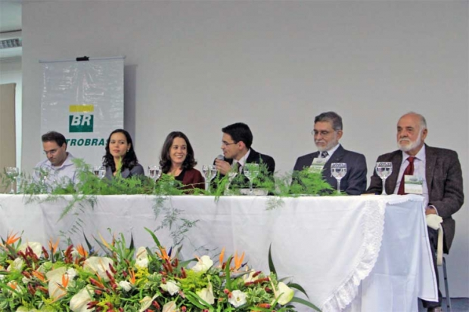
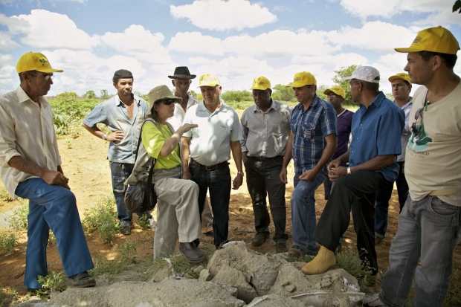
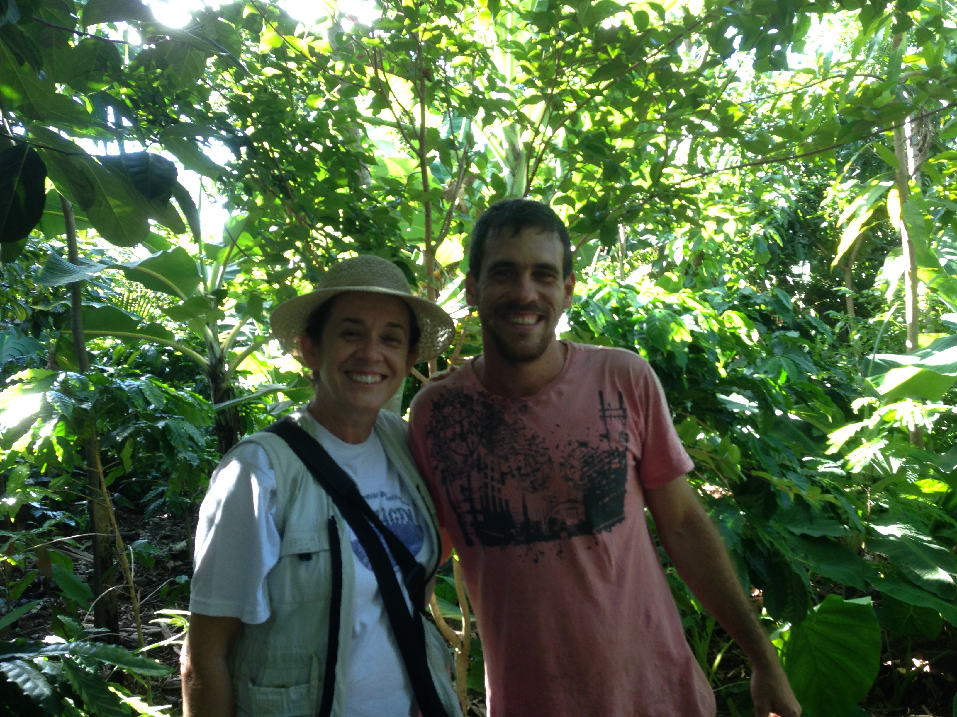
Connecting Research to Policy Makers and Advocates
Brazil 2013
EMPRABA
Bahia agriculture
Brasilia agroforestry

Slide 12
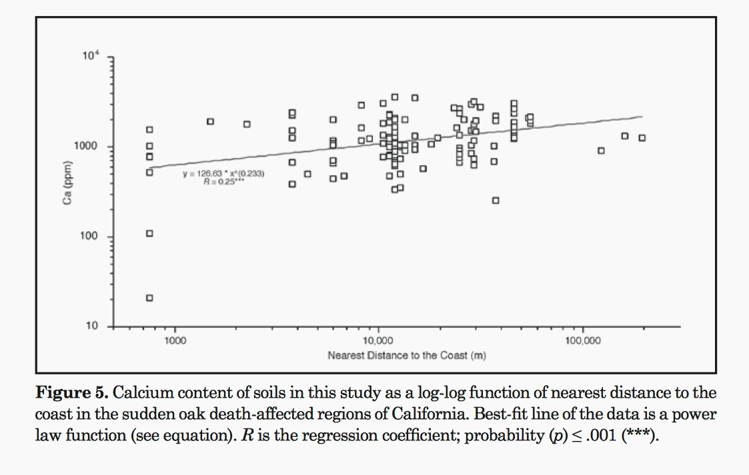
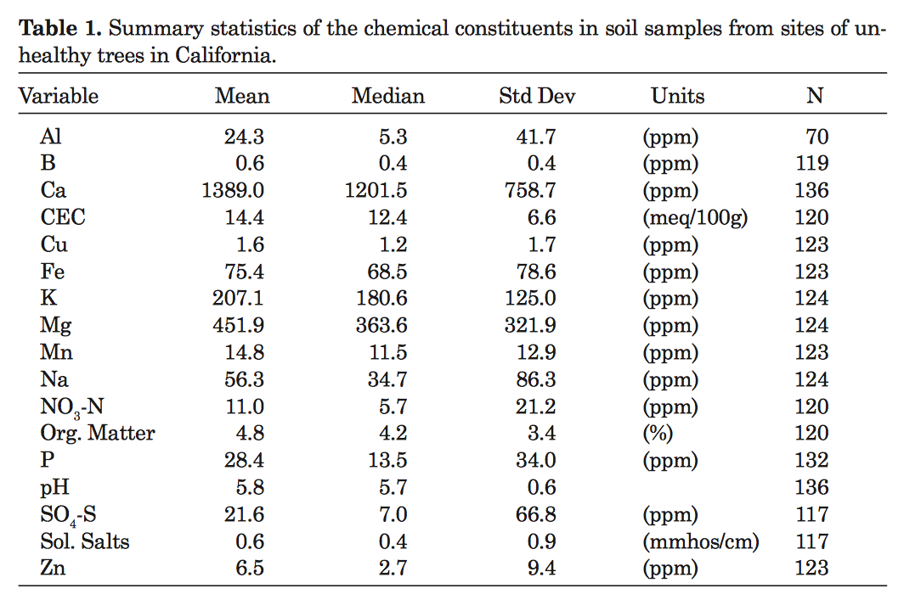
We have the only…
research database
online dedicated solely to remineralization.
Byrophytes and soil acidification effects on trees: the case of sudden oak death
Lee F. Klinger
Saving dying oaks using rock dust

Slide 13
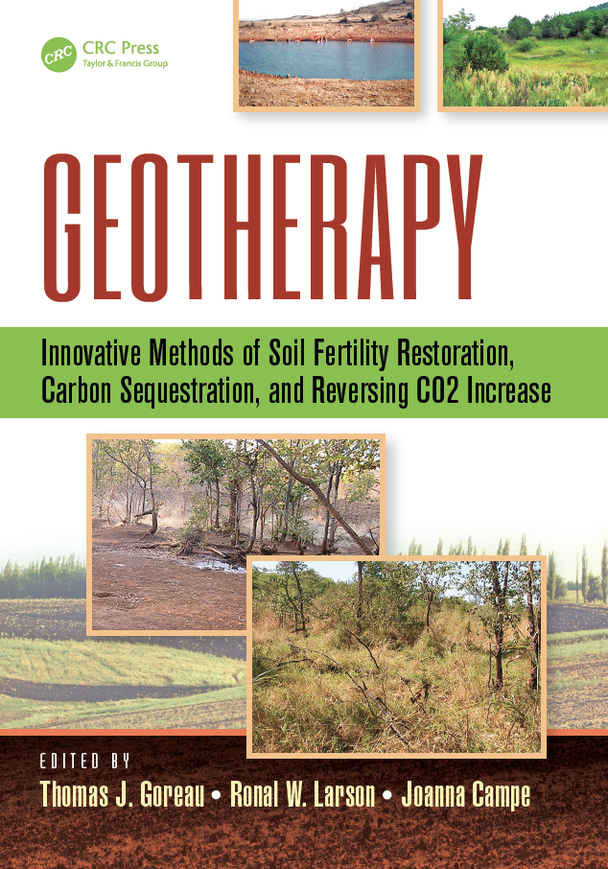
New research papers with comprehensive data showing the benefits of rock dust and biochar
A guide to policy-making and practical steps to restore severely damaged ecosystems
Notes:
The large-scale restoration of damaged ecosystems is essential if the climate is to be stabilized.
Research culminating with new studies on rock dust and biochar
December 2014 release for UN conference in Lima, Peru

Slide 14
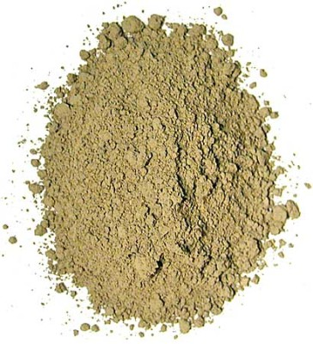
We are the only…
organization connecting the growing industry of commercial rock dust and sea minerals to the grassroots and agricultural sector.
Gaia Green Glacial Rock Dust
Notes:
Find agricultural image
Brix blend to be used somewhere
Needs a different photo!

Slide 15
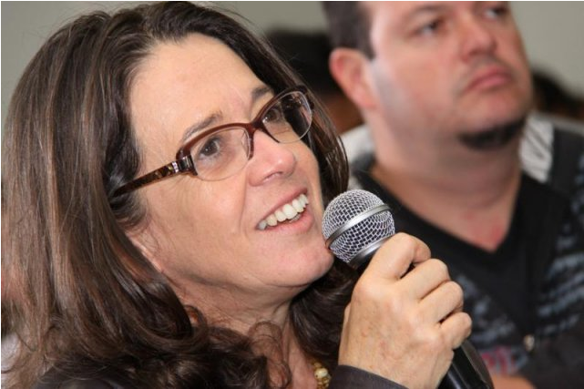
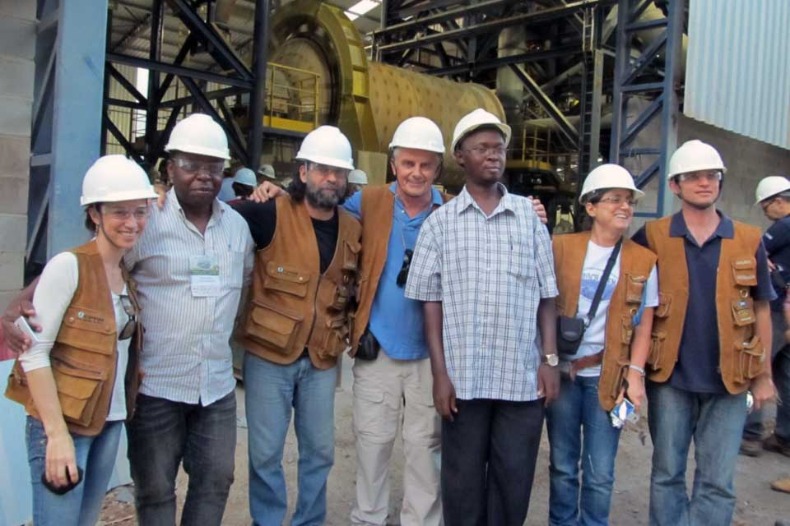
We are the only…
group advocating at the international level for remineralization projects and investment.
Brazil conference, April 2013
Brazil Enacts
Groundbreaking Legislation
for Sustainable Agriculture
Embrapa research team and speakers visiting Brazil quarry
Notes:
She is a technical advisor, on our Board of Advisors

Slide 16
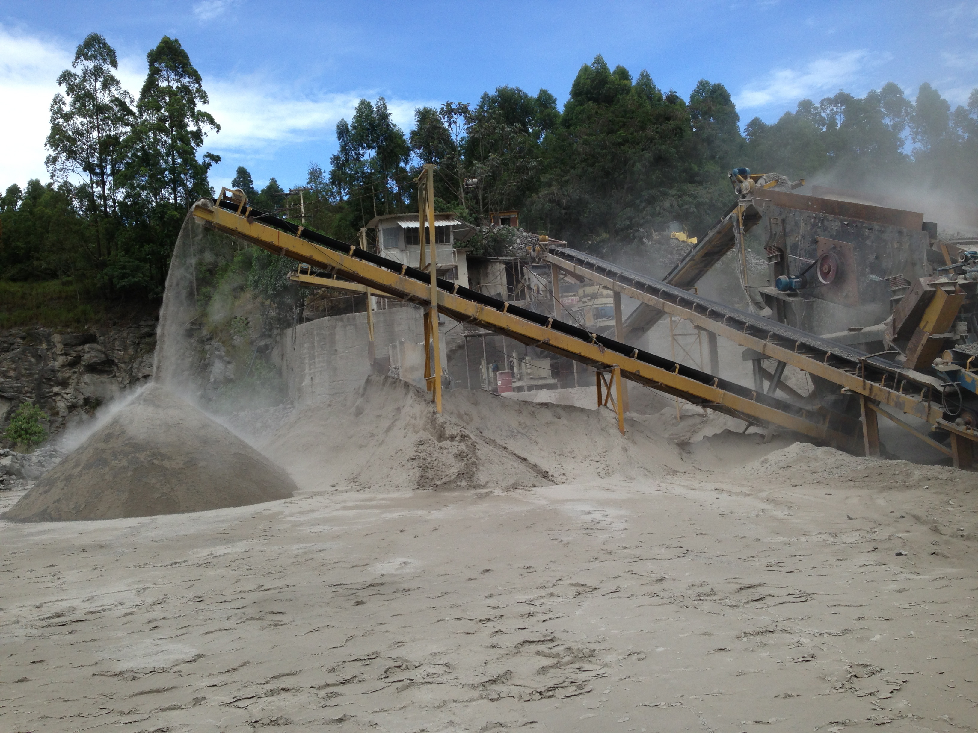
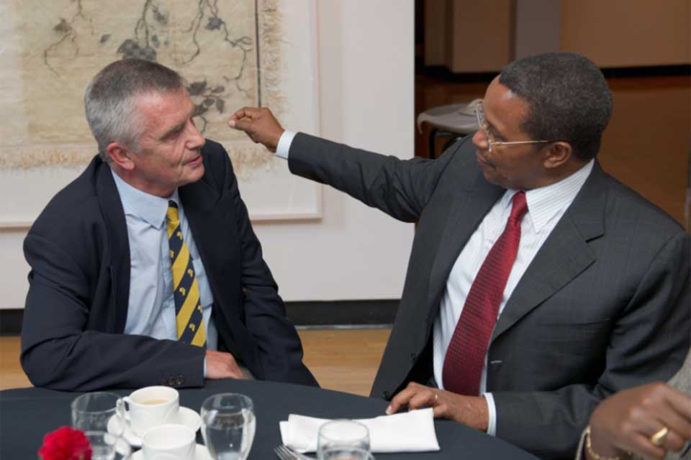
We are leading the charge and deeply embedded in the industry and movement.
Quarry near Brasilia
Dr. Peter van Straaten with
Tanzanian President, Jakaya Kikwete
Notes:
New photos

Slide 17
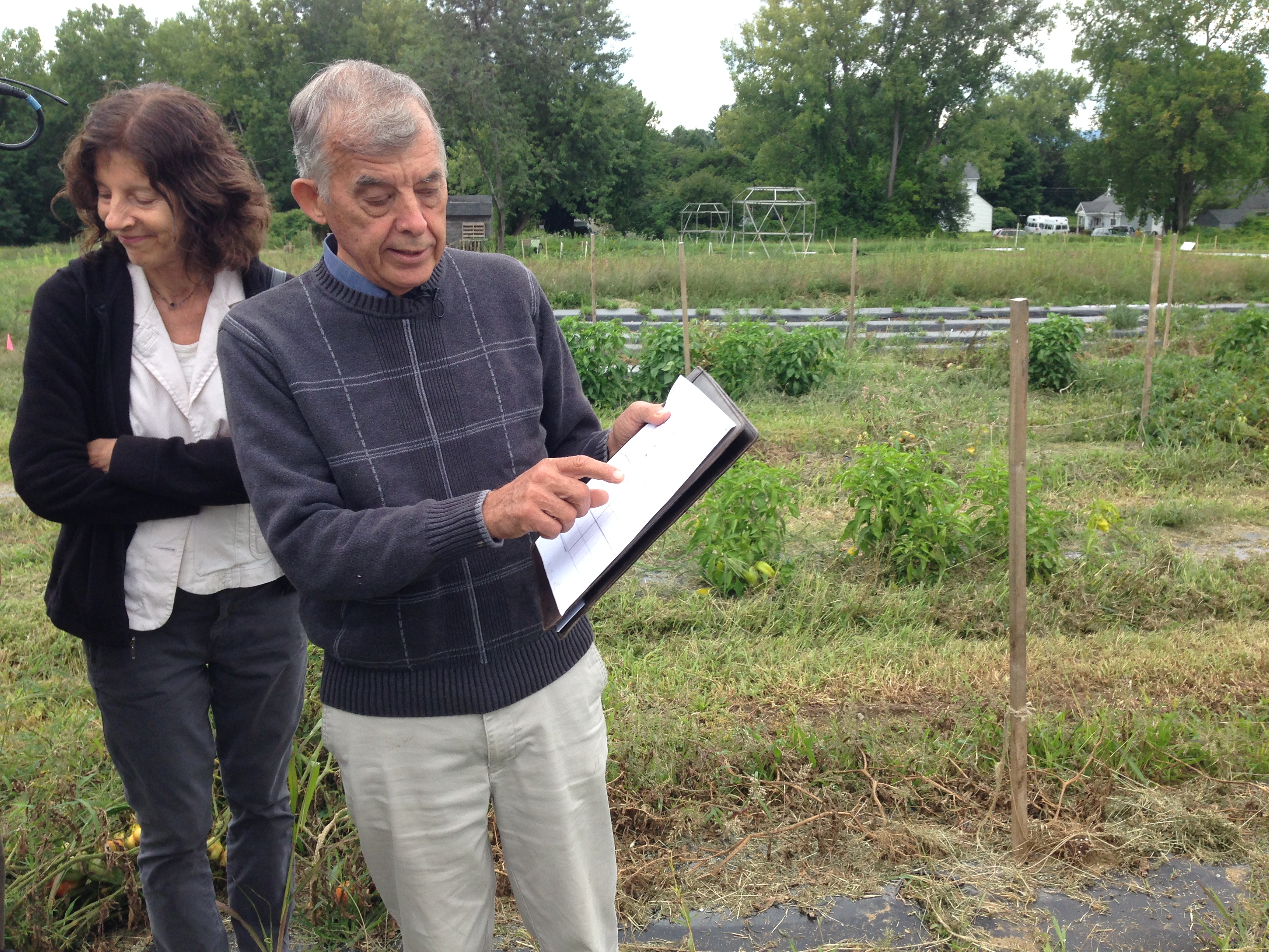
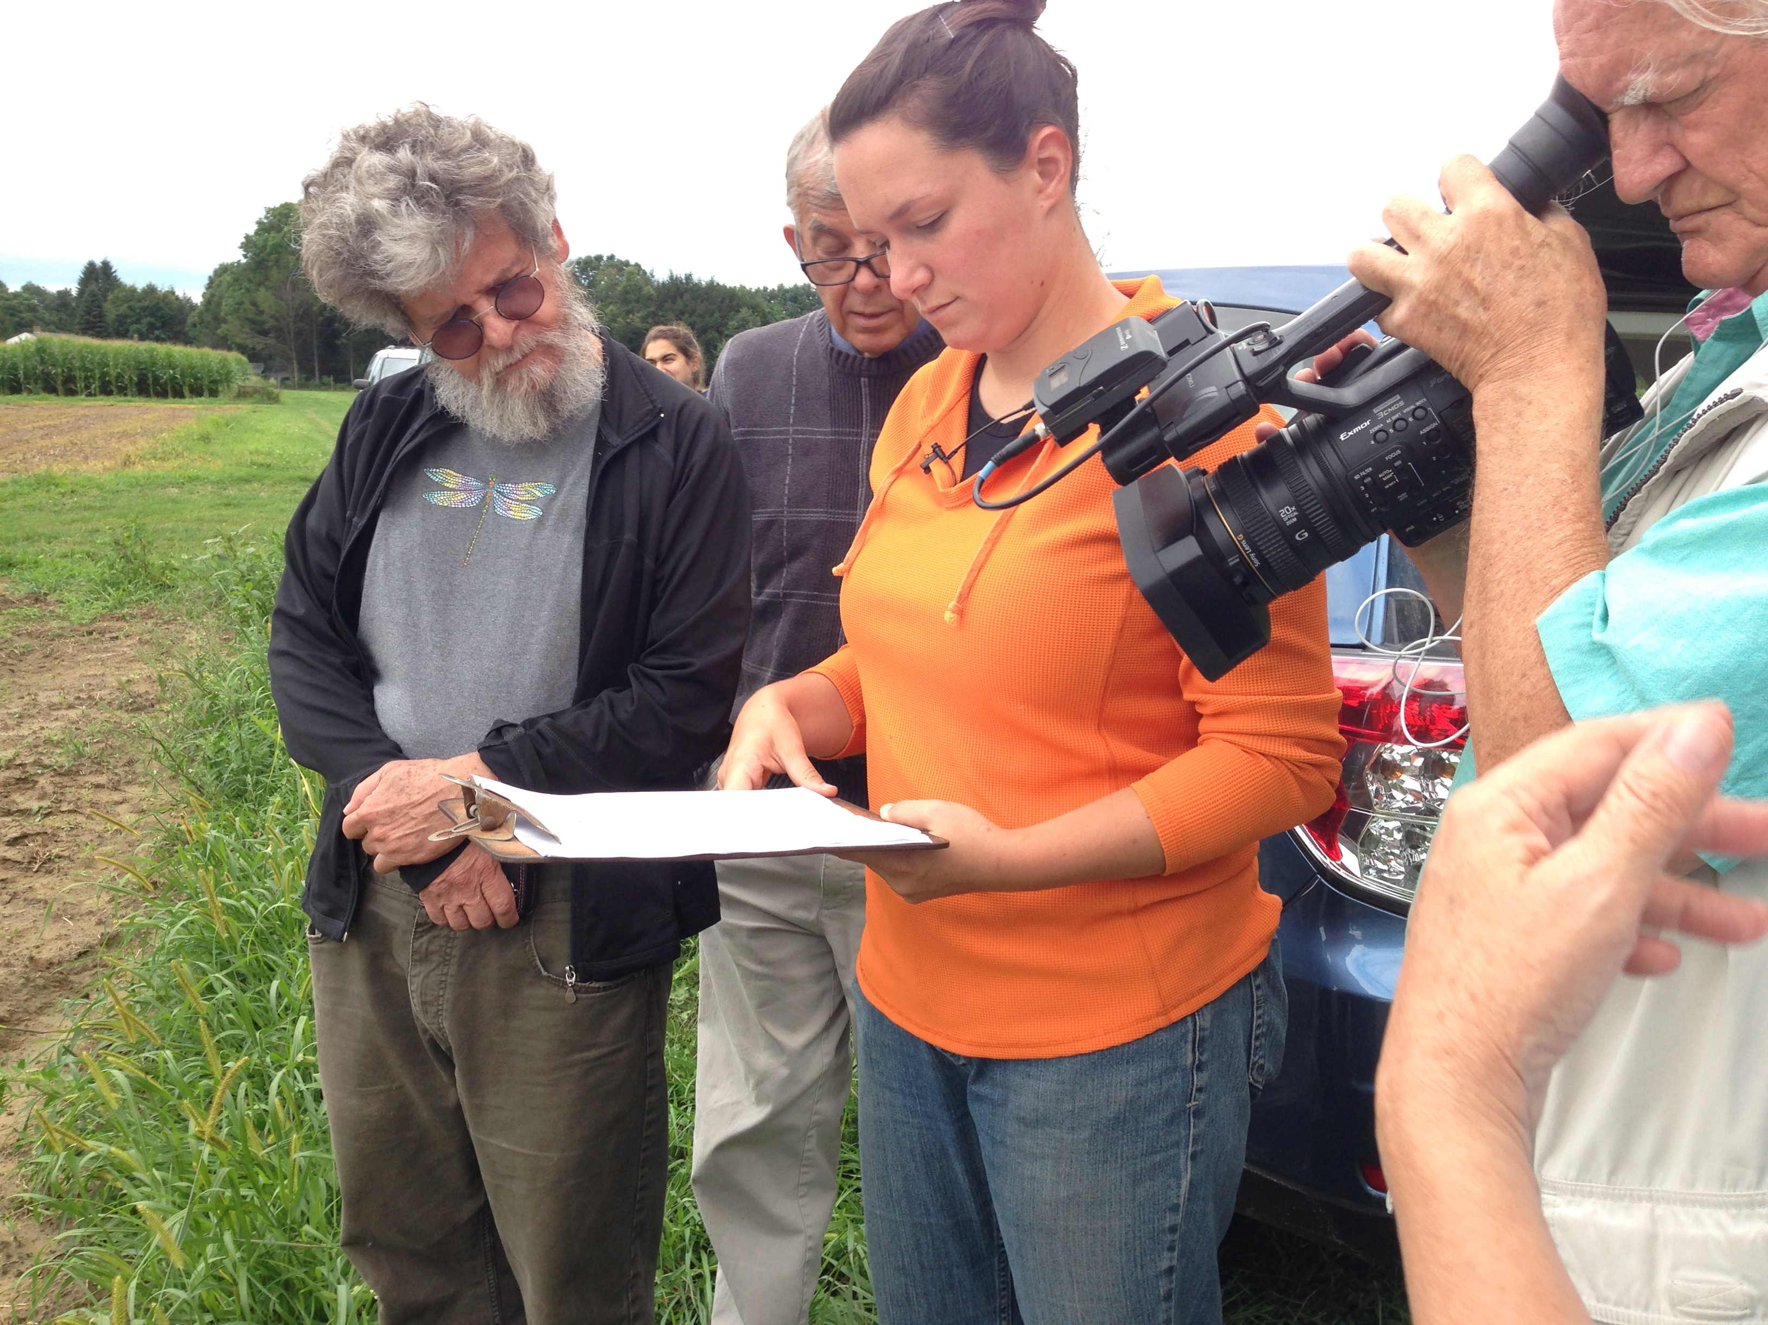
Our Projects
We are initiating local and global projects.
University of Massachusetts Research Sites

Slide 18
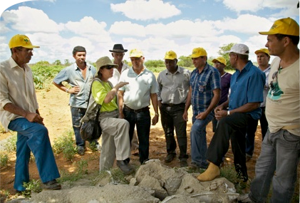
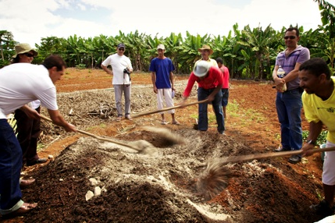
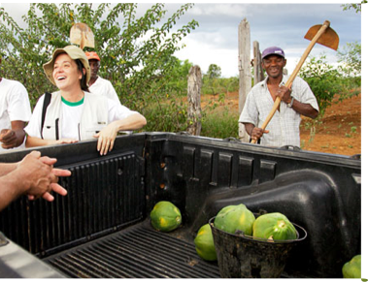
Brazil

Slide 19
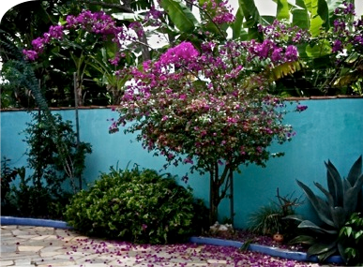
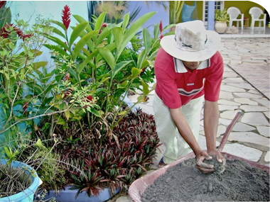
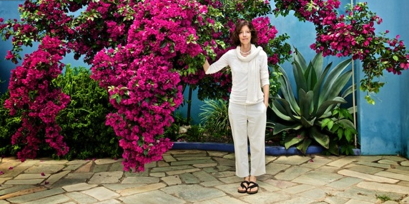
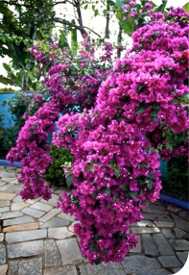
Before Remineralization
Local basalt rock dust
After 6 weeks
Remineralizing bougainvillea near Brasilia
Goiás, Brazil - 2010

Slide 20
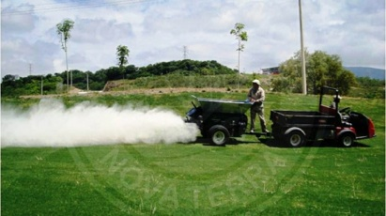
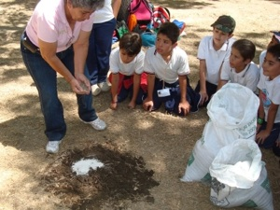
Increasing Crop Yields in Mexico
Remineralization of 22,000 hectares with government subsidies (2008-2009)
Zacatecas
After a huge decline in bean production from 2002-2007 rock dust replaced Urea and increased production 300%.
Production of corn, grape, peach, nopal and several varieties of chili pepper also increased.
Zapopan, Jalisco
Farmers were trained to use rock dust in 28 towns. The government initiative included public parks, gardens, and a forest area.
500 children attended a workshop to learn how to remineralize trees with rock dust.
Mexico
Agro Insumos Nova Terra SA

Slide 21
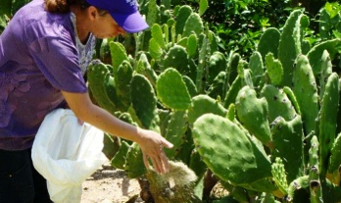
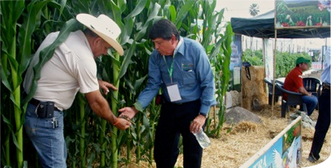
ECOAGRO Farmer’s Collaborative in Sinaloa
A farmers collaborative is at the forefront of campaigns promoting the use of rock dust.
Mexico

Slide 22
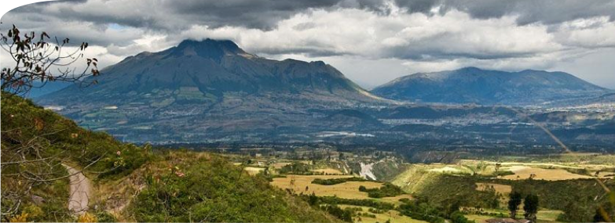
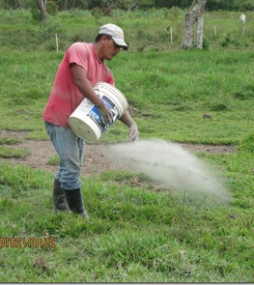
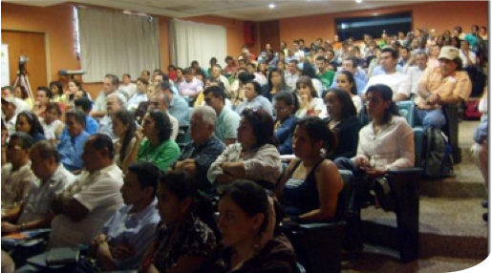
Western Andes Range
Colombia
Agrempacados E.U.

Slide 23
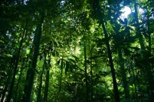
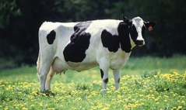
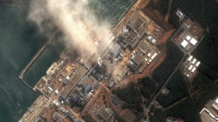
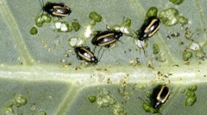
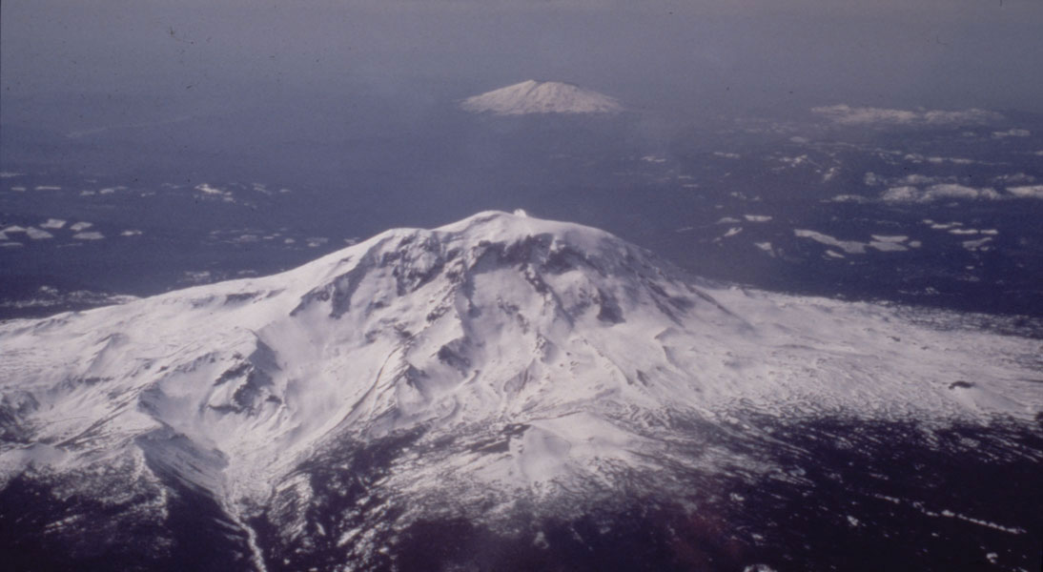
Our Mission is Ambitious
Carbon Sequestration
Dairy & Livestock
Bioremediation
Pest Control
Sustainable Biofuels
Stabilizing the Climate
Notes:
Redo this and add in bio-fuel production
What else? Think about this with Nathan

Slide 24
The Potential of Remineralization
Transforming ecological, economic and social challenges on a regional and global scale
Advancing Renewable Energy in Latin America and Integrated Farm Energy Systems, RELACCx, Puerto Rico, November 19, 2014
Notes:
Larger picture of remineralization and our organization
Remineralization addresses local and global challenges – Thesis statement, if you will

Slide 25
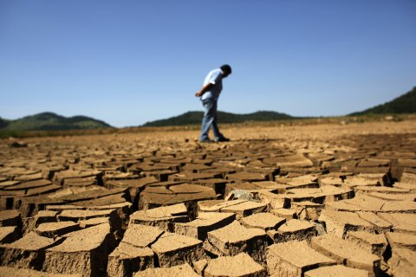
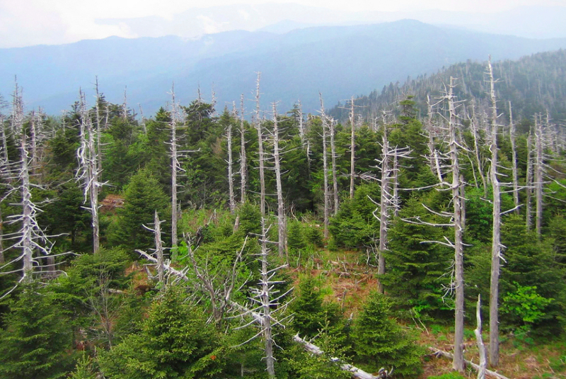
Humanity’s Challenges are Numerous
We can create better soils, better food, and a better planet.

Slide 26
The Opportunity of Remineralization
Carbon Sequestration
Dairy & Livestock
Bioremediation
Pest Control
Sustainable Biofuels
Stabilizing the Climate
Notes:
Redo this and add in bio-fuel production
What else? Think about this with Nathan

Slide 27
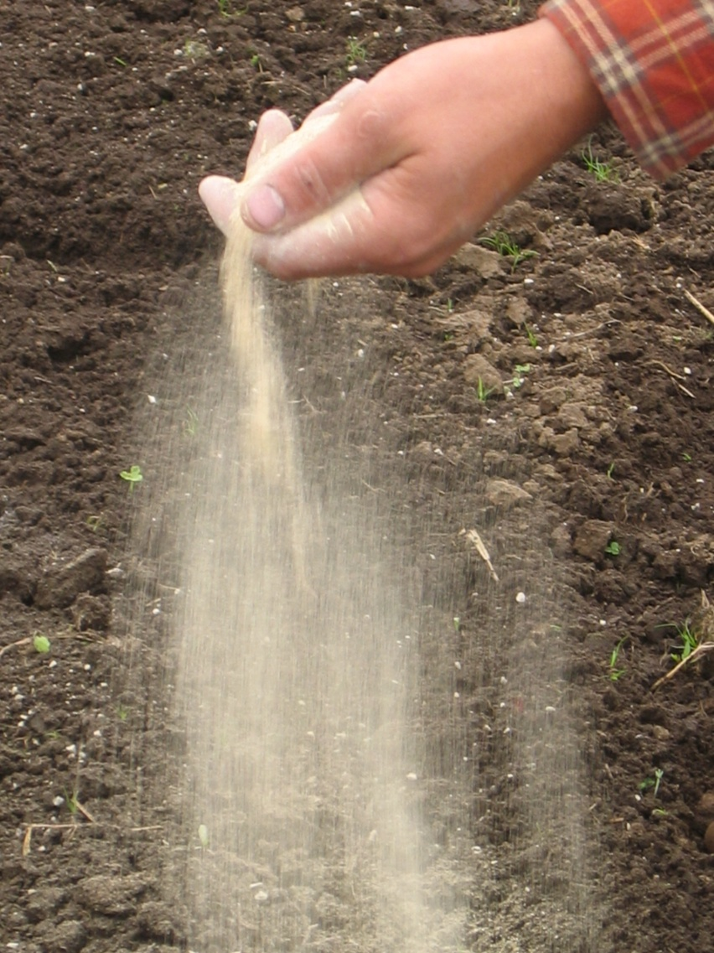
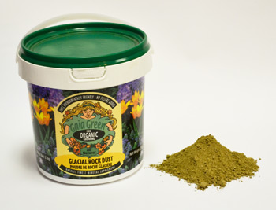
Waste to Valuable Product
Rocks are the most abundant resource on earth.
We can move from an economics based on scarcity using fossil fuels to an economics of abundance through remineralization.
Notes:
Where to put this photograph of the national gravel Association?
According to Peak Oil expert Richard Heinberg, 37% of the U.S. energy budget is for agriculture. Remineralization and local food systems are a key strategy to transition us to a low energy based economy.
Little processing required
$0-$8/ton for cost (majority of the cost is in the transportation of the good)
Net carbon positive, non-toxic, etc.

Slide 28
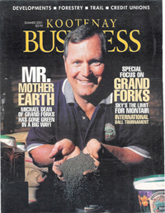
Gaia Green is one of the earliest companies based in Canada, markets online and at gardening centers in Canada and the US.
Interested in international markets, such as China
Michael Dean, Founder
Notes:
Gaia Green is one of the earliest companies marketing glacial rock dust for Canada and the US at gardening centers and online. They are now formulating products that include basalt and glacial materials to get a very broad spectrum of nutrients and trace mineral. They are interested in the international market, such as China.
100% Canadian Glacial Moraine , 100% Canadian Volcanic Basalt, Premium Rock Dust Blend

Slide 29
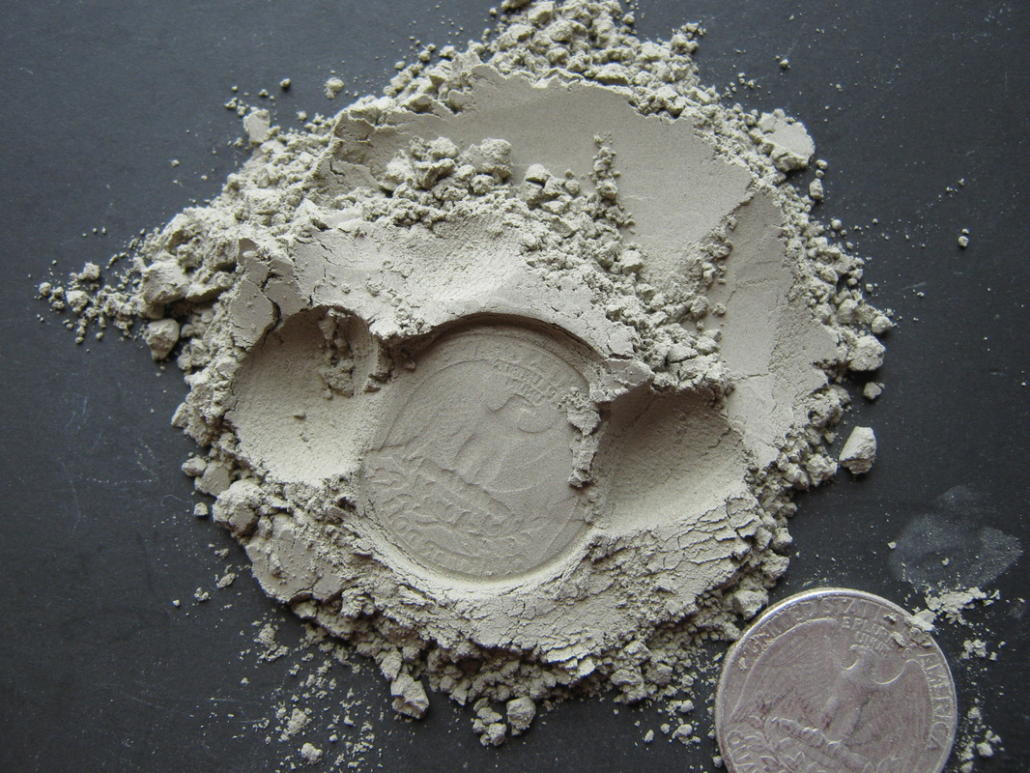
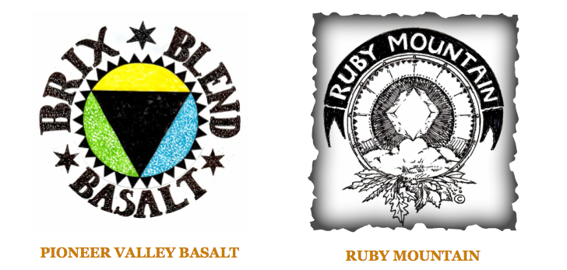
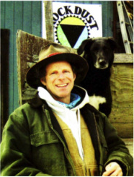
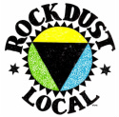
Rock Dust Local was established as the first company in North America specializing in local and regional sourcing of rock dust for remineralization.
Blends different gradations of finenesses from grits to microfine dust to achieve short-term to longer-term remineralization
Tom Vanacore, Founder
Notes:
Suggested use:
5-50 lbs/100 sq.feet in tillage or cultivation.
5-25 lbs./100 sq. ft. top dressing.
Fortify compost with 15-20 lbs./cu yd of raw biomass.

Slide 30
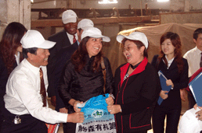
Growth Potential – Services and Products
Notes:
Notice that this is a vast industry with tremendous opportunity for creating products and marketing & distributing

Slide 31
Growth Potential – Niche Markets
Notes:
Preventions botrydis and phylloxera

Slide 32
Risk Management, Prevention, and Mitigation
Fukushima clean up utilizing biochar and rock dust
Notes:
http://www.huffingtonpost.com/2013/12/30/chinese-farmland-polluted_n_4517601.html
Bioremediation of soils (China and Japan)
China for restoring agricultural land

Slide 33
Sustainable Biofuels
Putting an end to the food versus fuel debate with remineralization
Jatropha
Renewable Energy

Slide 34
Integrated Systems
Remineralization can be integrated into all kinds of systems that utilize:
biochar
microrganisms
compost & compost teas
worm castings and vermiculture
permaculture, etc.
IF⁵PS enterprise looks towards cutting edge technologies.
Notes:
Large scale restoration of damaged ecosystems is essential if the climate is to be stabilized.
The most productive ecosystems on land need to maintain high biodiversity. Revolutionary new methods resolve major factors limiting ecosystem growth, productivity, and the capacity to resist severe environmental stresses while simultaneously increasing global carbon storage and decreasing atmospheric CO2
Remineralization can be integrated into all kinds of systems utilizing advanced technologies such as microrganisms, compost teas, permacultures, biocharIF⁵PS enterprise

Slide 35
Partners moving forward
Research
Policy
Agrogeologists
Agronomists; Soil Scientists
University Agricultural Researchers
United States Geologic Survey
Dept. of Interior
International Development Agencies United States Department of State (USAID)
United Nations
Industry and Technology
Mining and Aggregates
Soil and Ag Amendments
Manufacturers and Distributors
Biofuels and Biochar Manufacturers
Biofuels technology developers
Transport and Logistics
Finance
Notes:
And in all these efforts we have existing partners
Our next round of partners

Slide 36
Thank You!
Help us sustain our mission to Remineralize the Earth
Notes:
We can initiate projects large and small worldwide partnering with other NGOs, government agencies, international development and companies to regenerate soils, increase agricultural yields, the nutrient density did grow nutrient dense food, reomineralization can be a key strategy towards stabilizing the climate

